Slide 1

Ethical Data Use Checklist App
A Python CLI Tool for Responsible Data Practices
Presented by: Saurabh Rai
IIT Patna, 2nd Year | Guvi HCL Contribution

Slide 2

Introduction
In an era driven by vast amounts of data, ethical data practices are not just a regulatory compliance matter but a fundamental necessity for building trust and ensuring societal well-being. From personal privacy to algorithmic bias, the implications of data misuse are far-reaching. This project, an Ethical Data Use Checklist App, addresses the critical need for a practical tool to guide developers and organisations in adhering to responsible data handling principles. It aims to embed ethics directly into the development lifecycle, ensuring that data-driven innovations are built on a foundation of integrity.

Slide 3




The Problem Statement
Data Privacy & Security
User Consent Management
Organisations struggle to consistently implement robust measures to protect sensitive user data from breaches and unauthorised access, leading to significant risks.
Obtaining and managing explicit, informed user consent for data collection and usage is complex, often leading to opaque practices and user distrust.
Fairness & Bias Mitigation
Transparency & Accountability
Algorithms trained on biased datasets can perpetuate and amplify societal inequalities, making it challenging to ensure equitable outcomes and prevent discrimination.
Lack of clear documentation and processes makes it difficult to audit data practices, understand decision-making, and assign accountability for ethical lapses.
These challenges underscore the need for a systematic, accessible approach to guide data practitioners towards ethical compliance, moving beyond reactive measures to proactive integration of ethical considerations.

Slide 4
Project Objectives
1
Develop a User-Friendly Python CLI Tool
2
Standardise Ethical Assessment
Create an intuitive command-line interface application that guides users through a series of ethical data considerations.
Establish a consistent checklist approach for evaluating data projects against key ethical principles like privacy, consent, and bias.
3
Provide Actionable Insights
4
Promote Ethical Awareness
Generate a clear ethics score and tailored recommendations, highlighting areas of compliance and those requiring attention for improvement.
Serve as an educational resource, making complex ethical concepts accessible and fostering a culture of responsible data stewardship within development teams.

Slide 5




Methodology
Our approach combines best practices in ethical data guidelines with practical software development principles to create a robust and easy-to-use tool.
Checklist Creation
Python CLI Development
Research and synthesise ethical guidelines from GDPR, CCPA, AI ethics frameworks (e.g., NIST AI Risk Management Framework), and industry best practices to formulate comprehensive checklist questions.
Implement the checklist in Python using standard libraries, focusing on a clean, interactive command-line interface for ease of use and accessibility.
Scoring Logic & Reporting
Testing & Refinement
Develop a transparent scoring mechanism where each 'No' response reduces the ethics score, and integrate a reporting module to summarise compliance and highlight critical issues.
Rigorously test the application with various hypothetical data projects to ensure accuracy, reliability, and provide meaningful feedback, iterating based on user experience.

Slide 6
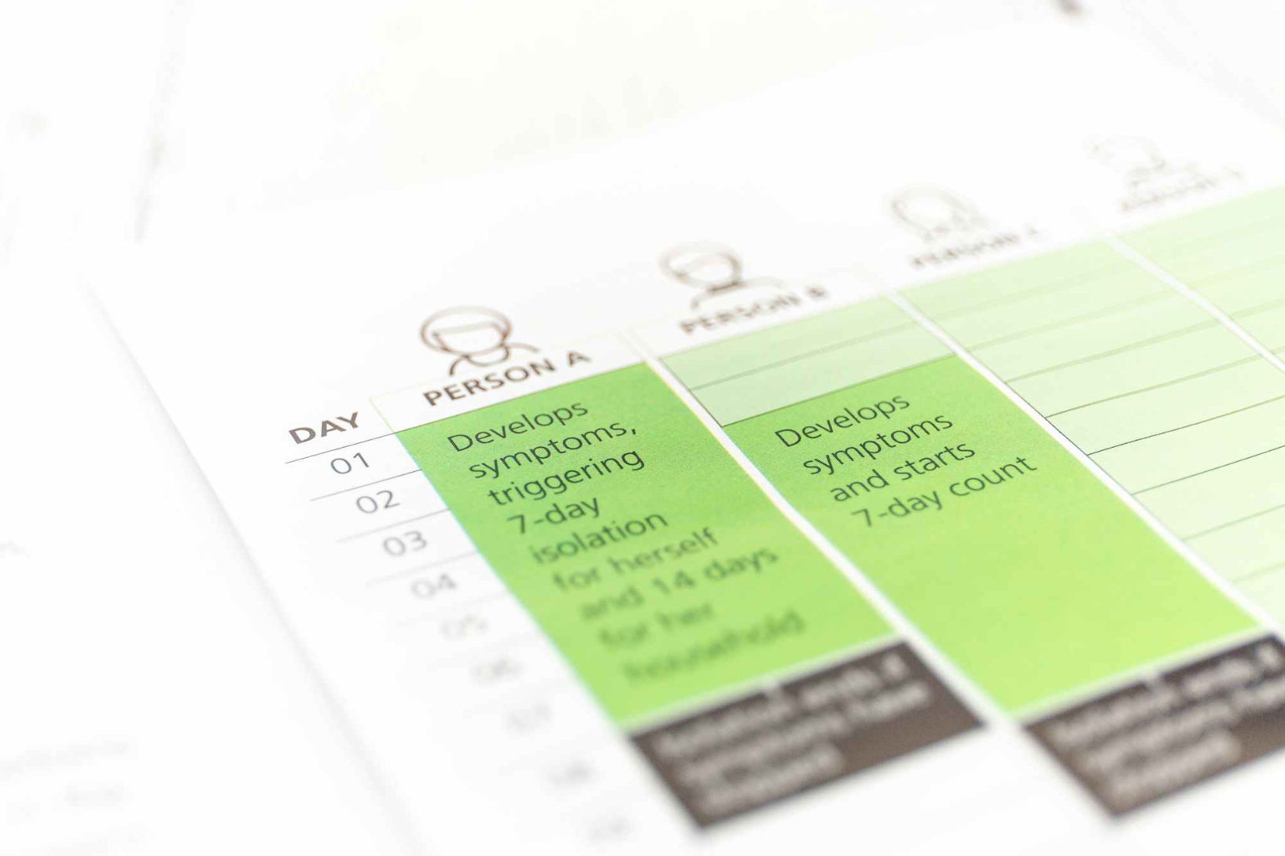
Functional Components
The Ethical Data Use Checklist App is designed to be highly functional and user-centric, offering key features that facilitate a comprehensive ethical review process:
Interactive Checklist Interface: Users are prompted with a series of Yes/No questions, making the assessment process straightforward and guided.
Dynamic Scoring System: A real-time scoring mechanism calculates an overall ethics score based on user responses, providing immediate feedback.
Detailed Ethical Reporting: Upon completion, the app generates a summarised report indicating compliance status and flagging specific areas that require ethical attention or further action.
Recommendation Engine (Future Scope): Planned feature to offer context-specific guidance and best practices for addressing identified ethical gaps.

Slide 7
Example Checklist Items
The checklist covers a broad spectrum of ethical considerations to ensure holistic assessment:
Privacy & Data Minimisation
Transparency & Explainability
Is all collected data strictly necessary for its stated purpose?
Is the data collection and usage process clearly documented?
Are strong encryption and anonymisation techniques applied where appropriate?
Can algorithmic decisions be explained to affected individuals?
Security & Governance
Is data retention limited to the minimum necessary period?
Are data access controls strictly enforced?
User Consent
Is there a clear ethical governance framework in place?
Is consent explicitly obtained, informed, and easily withdrawable?
Accountability
Are consent mechanisms transparent and user-friendly?
Are roles and responsibilities for ethical data handling clearly defined?
Fairness & Bias
Have datasets been checked for inherent biases?
Is there a mechanism for addressing ethical complaints?
Are algorithms regularly audited for discriminatory outcomes?

Slide 8
High-Level Implementation
The core of the application is built in Python, leveraging its simplicity and versatility for command-line interfaces. We've structured the code modularly to ensure scalability and maintainability.
# main.pydef run_checklist(): score = 10 responses = {} questions = get_checklist_questions() # From questions.py for category, qs in questions.items(): print(f"\n--- {category} ---") for q_id, q_text in qs.items(): response = input(f"{q_text} (Yes/No): ").lower() responses[q_id] = response if response != 'yes': score -= 1 # Simple scoring logic display_results(score, responses) # From reporting.pyif __name__ == "__main__": run_checklist()# questions.py (simplified)def get_checklist_questions(): return { "Privacy": { "q1": "Is all collected data strictly necessary for its stated purpose?", "q2": "Are strong encryption techniques applied?" }, "Consent": { "q3": "Is consent explicitly obtained and easily withdrawable?" } }# reporting.py (simplified)def display_results(score, responses): print("\n--- Ethical Compliance Report ---") print(f"Overall Ethics Score: {score}/10") if score == 10: print("Status: Highly Compliant

Slide 9

Results: Case 1 - Fully Compliant
Scenario: A data project with robust privacy controls, explicit consent mechanisms, and regular bias audits. All ethical considerations have been meticulously addressed.
10/10
Highly Compliant ✅
This score signifies that the data project adheres to all ethical guidelines and best practices outlined in the checklist. It demonstrates a strong commitment to responsible data stewardship, ensuring user trust and regulatory compliance. No immediate actions are required, but continuous monitoring is always recommended.

Slide 10

Results: Case 2 - Needs Attention
Scenario: A data project that has some privacy measures but lacks clear consent withdrawal options and has not performed recent bias checks on its data.
7/10
Needs Attention ⚠️
A score of 7/10 indicates that while the project has some ethical considerations in place, there are critical areas that require immediate review and improvement. The report highlights specific questions where responses were 'No', guiding the team to implement necessary changes in consent management, bias mitigation, or data security protocols to achieve full compliance.

